Slide 1
Lending Club Dataset
Case study

Slide 2
Problem statement
Lending club loan dataset
Contains information about lending club loans along with loan status
Business problem
To find the driver variables for target variable loan status
Predicting when a loan is more likely to be defaulted, will help prevent losses

Slide 3
EDA Strategy
Data Cleaning
Univariate Analysis
Multivariate Analysis

Slide 4
Data Cleaning
Remove columns which have more than 30% missing values
Remove remaining rows which still have missing values
Convert to correct datatypes
Strip characters to convert to numeric format (eg. months, %)
Convert fields with months to period type in pandas
Remove outliers that are below 5th percentile and above 95th percentile
Create new columns to aid analysis
Ratio of loan amount to annual income
Conversion of target variable to numeric values
Paid - 0
Charged Off - 1
Current - 2
Filter out loan status “Current” as it can’t be used to predict the relevant driver variables

Slide 5
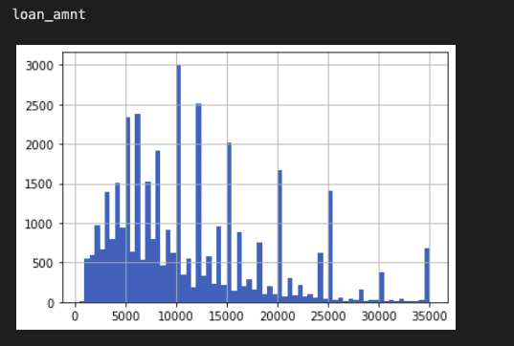
Univariate analysis
Plot histograms for all quantitative variables(example below)

Slide 6
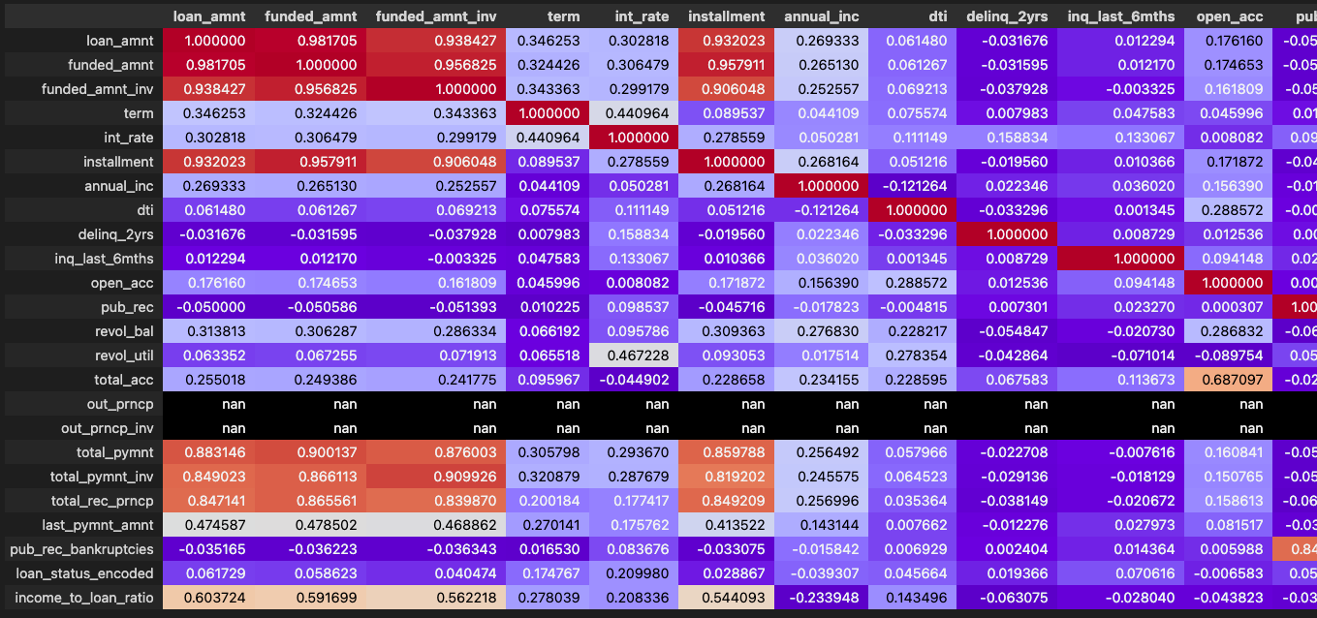
Multivariate analysis
Create correlation heatmaps like below to identify correlation of variables with the target variable.

Slide 7
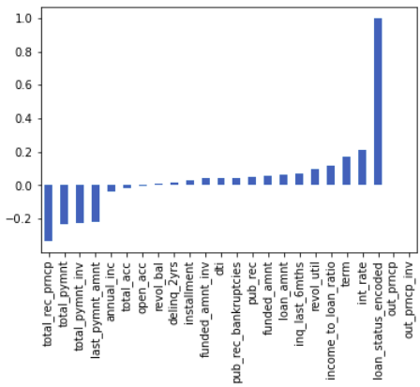
Multivariate analysis - continued
The correlation of target variables with all other variables are plotted in a bar chart

Slide 8
Driver variables
Relevant variables with high correlation (>0.05) are selected
Variables that are only present in ‘PAID’ loans are ignored
Driver Variables
Interest rate (Loan interest rate)
Term (Loan term)
Revol_util (Revolving line utilization rate)
Income_to_loan _ratio (Calculated field - ratio between annual income and requested loan amount)
Inq_last_6mnths (Number of credit inquiries)
Pub_rec (public record)

Slide 9
Next steps
Refine the driver variables and validate it
Model the relationship between driver and target variables
Use the model on ‘Current’ loan to identify the loans that might be charged off in near future.
Updated dataset can be used to confirm the validity of our prediction.

